Slide 1
NE 795: Advanced Reactor Materials
Fall 2023
Dr. Benjamin Beeler

Slide 2
Last Time
Austenitic steels undergo excessive void swelling in fast reactor conditions
F/M steels have good mechanical properties, are cheap, and their microstructure can be tailored through composition and fabrication
M23C6 and monocarbide precipitate are prevalent both along grain boundaries and within the grains; M2X metallic precipitates form and can be converted to Laves phases
F/M steels swell very little due to fundamental nature of defects in ferrite, C-vacancy bonding, and dislocation-solute interactions
Tailoring of alloying elements has allowed for improved creep strength
Stress induced preferential nucleation/absorption (SIPN – SIPA)
Swelling interaction with creep

Slide 3
Fe-Cr-al steels

Slide 4
FeCrAl
FeCrAl alloys are expected to have excellent high temperature corrosion behavior and very low void swelling, making them viable candidates for both LWR and advanced reactors
Strong push over the last 10 years to develop FeCrAl after Fukushima, including it as an accident tolerant fuel concept
Alloying additions are weighed to target properties and microstructure
Too much Cr leads to sigma phase and alpha’ which cause embrittlement, while too much Al leads to the formation of Al intermetallics
Cr and Al act as bcc stabilizers such that FeCrAl is fully ferritic
Other alloying species are added to increase strength, modify precipitation, etc.

Slide 5
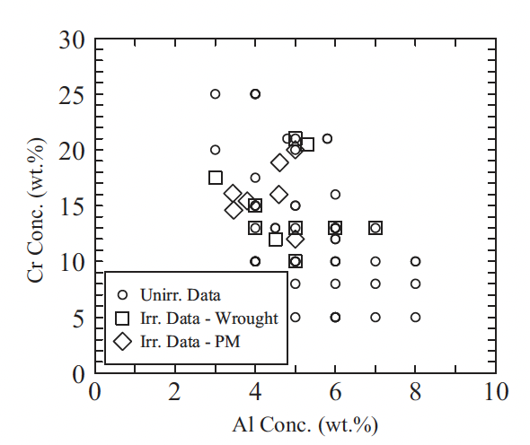
Compositional Limits
A range of alloys have been studied for radiation tolerance utilizing different fabrication techniques
Typically operate from 5-25 wt.%Cr and 2-8wt%Al
If too little Cr/Al is present, get poor high temperature corrosion resistance
To much Cr/Al, embrittlement and fabrication issues
To much of either Cr or Al, unfavorable precipitation behavior

Slide 6
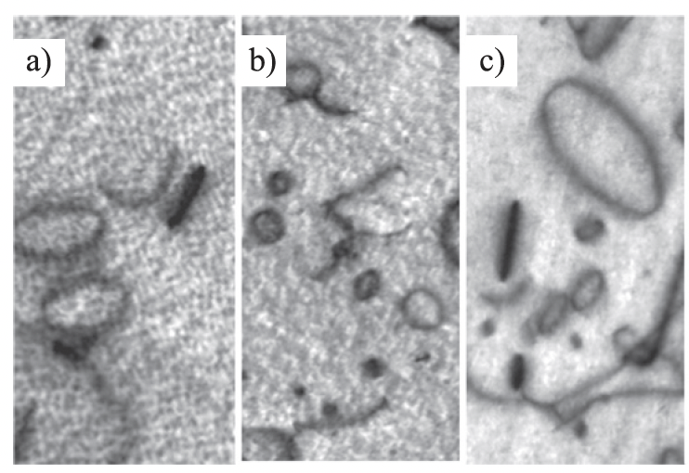
Irradiation Behavior
Effectively no void swelling has been observed up to 23 dpa and 600C
These alloys are expected to display excellent void swelling resistance characteristic of ferritic alloys
Both vacancy and interstitial loops of specific orientations are known to form, regardless of minor compositional variances
Loop size and density are impacted by composition and as-fabricated microstructure

Slide 7
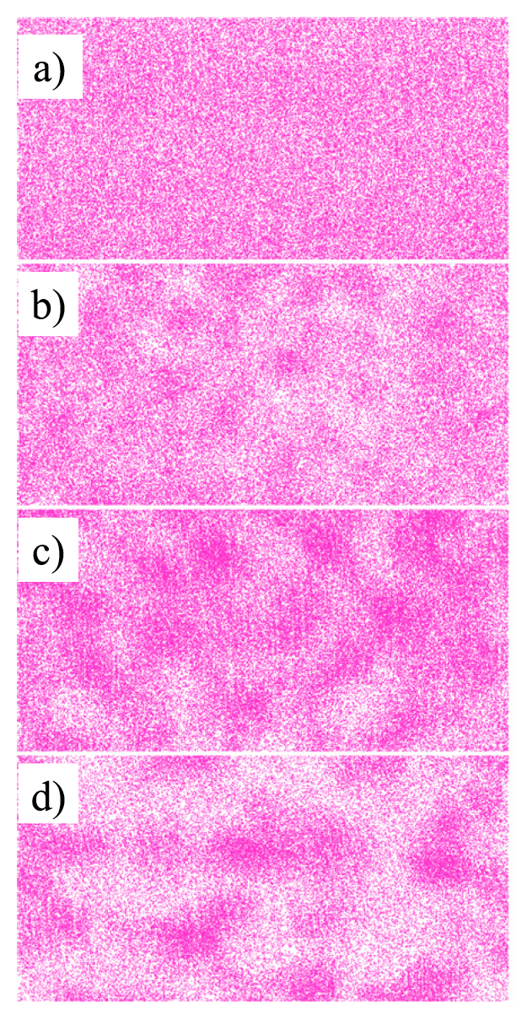
alpha’ Precipitation
Like other high-Cr ferritic alloys, FeCrAl alloys have been shown to be susceptible to irradiation-enhanced precipitation of the Cr-rich alpha’ phase
Embrittlement due to alpha’ formation has a high likelihood of being the primary factor dictating the useful lifetime of FeCrAl components
Aluminum is believed to inhibit, but not prevent, alpha’ precipitation
Irradiation enhanced diffusion accelerates the Cr precipitation, reducing the temperature and Cr-content at which alpha’ is expected to form
Atom probe tomography Cr atom maps during neutron irradiation

Slide 8
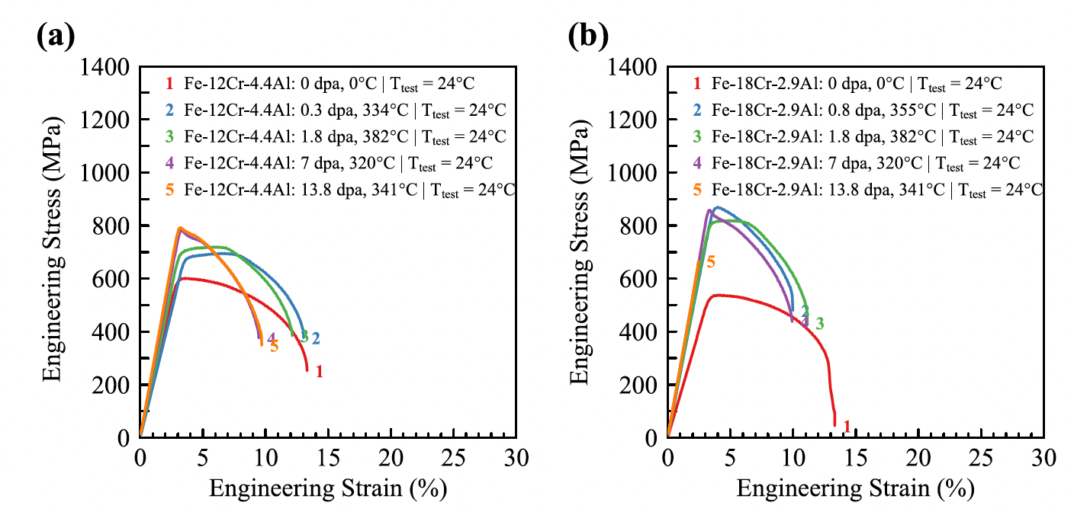
Irradiation Hardening
FeCrAl shows pronounced increases in yield strength and corresponding decreases in total elongation due to dislocations and alpha’ precipitates
The general trend is an initial regime where the yield strength steeply increases with increasing dose and then reaches a saturation
Saturation is typically around 10% elongation
Some high-Cr alloys have shown a third stage of complete embrittlement

Slide 10
ODS Steels

Slide 11
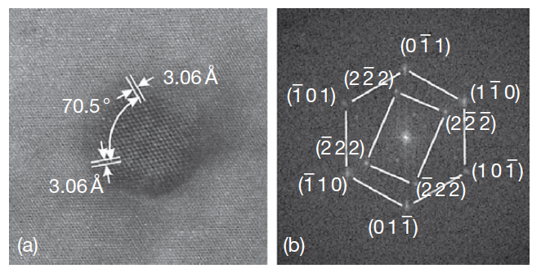
Oxide Dispersion Strengthened
Thermally stable oxide particles dispersed in the ferritic matrix improve the radiation resistance and creep resistance at high temperature
ODS steels have a strong potential for high burnup (long-life) and high temperature applications typical for SFR fuels
Typically, Y2O3 particles or Y2Ti2O7 particles
Y2O3 particle with surrounding matrix

Slide 12
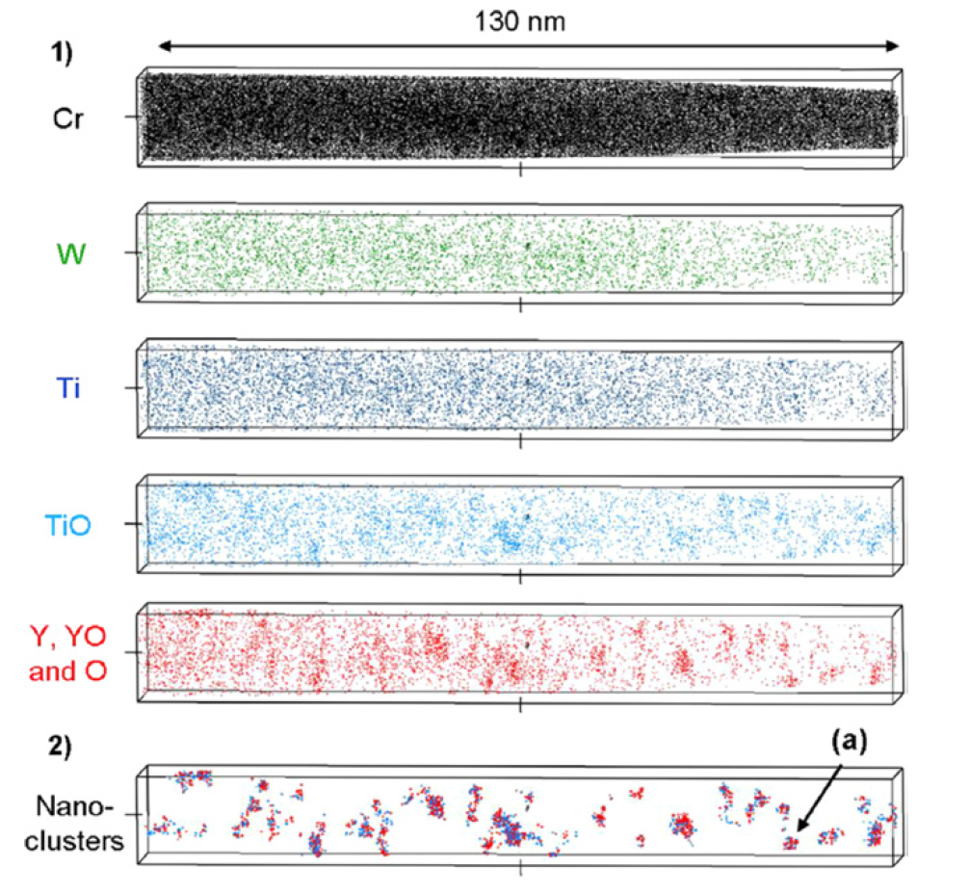
Y2O3 Decomposition
The fine distribution of Y2O3 particles is attained by the dissociation of stable Y2O3 particles which are forced to decomposed into the ferritic steel matrix during the mechanical alloying process
The lattice structure change of Y2O3 in the ODS steel during MA consists of three stages: (1) destruction of the lattice structure, (2) formation of a blurry lattice structure, (3) appearance of amorphous areas

Slide 13
9Cr-ODS
For nuclear applications, the choice of 9 wt% Cr with a tempered martensitic matrix is preferable to suppress the ductility loss by irradiation hardening and improve the microstructure stability and creep strength at high temperature
The high-temperature strength of 9Cr-ODS is drastically improved by nano-scale oxide particles dispersion in the matrix
The standard chemical composition of 9Cr-ODS being developed by the JAEA for SFR application is 9Cr–0.13C–0.2Ti–2W– 0.35Y2O3 (wt%)
The addition of titanium produces the nanoscale dispersion of oxide particles
Tungsten of 2 wt% is also added in order to improve high-temperature strength by means of solid solution hardening

Slide 14
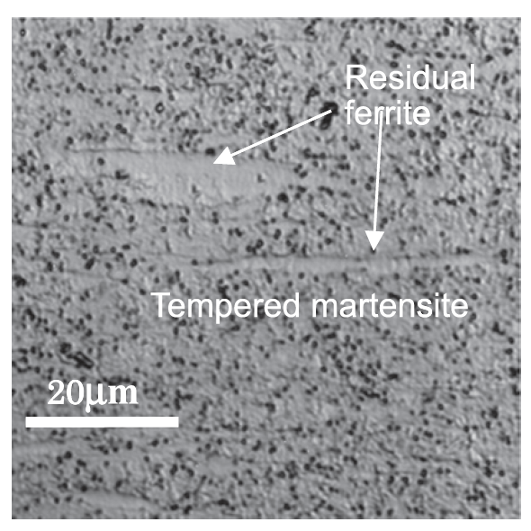
9Cr-ODS microstructure
The microstructure of 9Cr-ODS steel cladding is basically tempered martensite, but includes some residual ferrite phases
Only the full martensite phase can be expected in 9Cr-ferritic steel without yttria under the same conditions
The high temperature strength is greatly improved with the ferrite, and thus control of ferrite is key in ODS fabrication

Slide 15
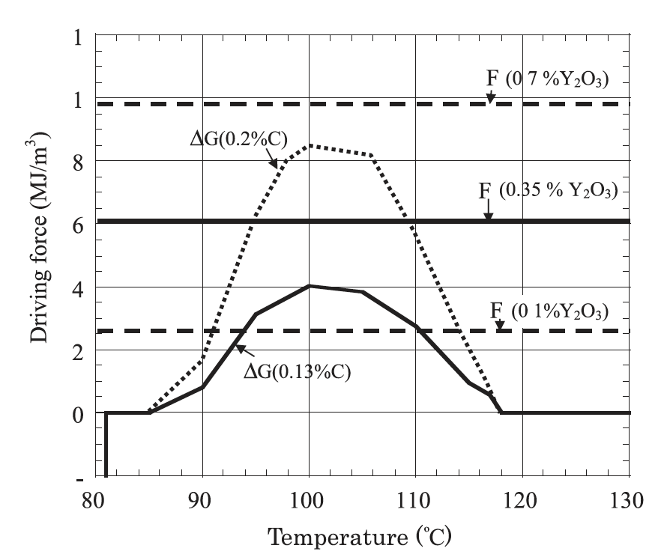
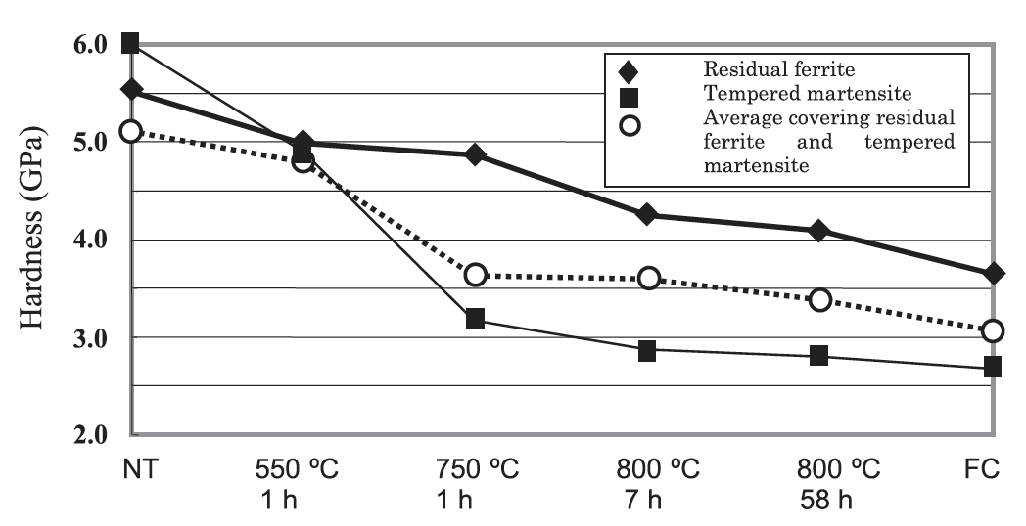
Residual Ferrite
Annealing results in the formation and precipitation of Y–Ti complex oxide particles at elevated temperatures of 700C or higher
Since the reverse transformation of alpha (ferrite) to gamma (austenite) takes place at a temperature over 850C, alpha ferrite is attributed to the presence of the Y-Ti-O particles
These particles block the motion of the alpha-gamma interface, there by partly suppressing the reverse transformation from alpha to gamma-phase

Slide 16
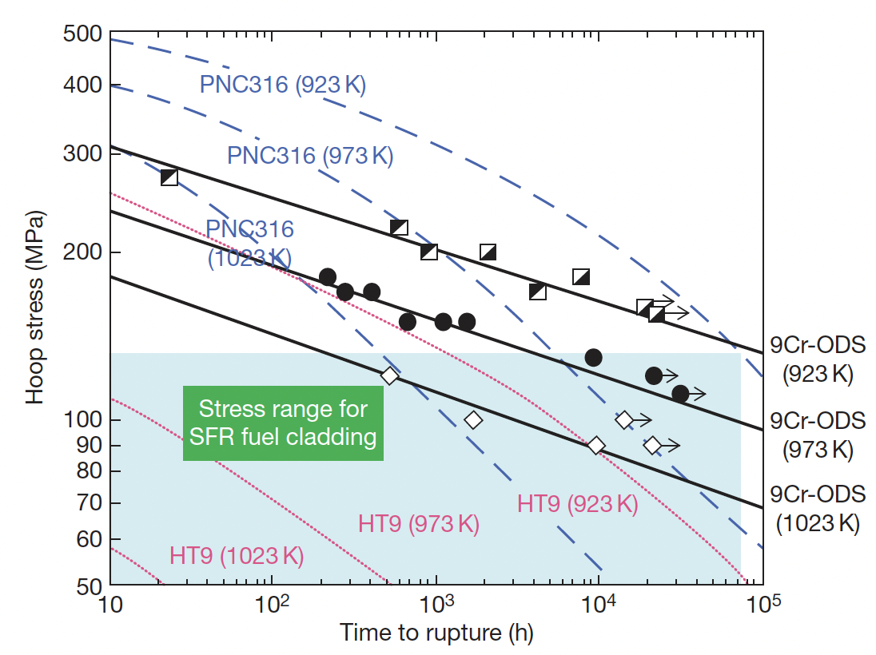
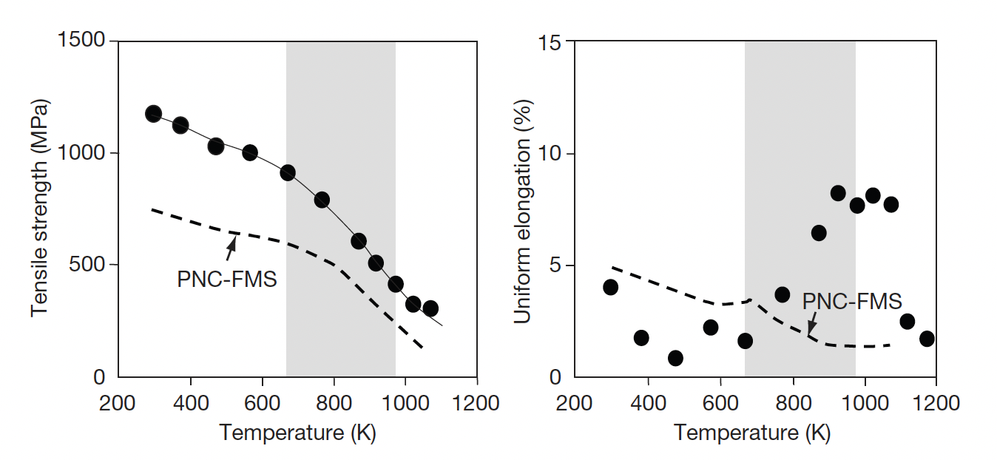
Mechanical Properties
The lifetime of a SFR cladding is mostly determined by the internal creep rupture strength with the internal pressure of the fission gas at a temperature of ~700C
PNC316 is austenitic steel used developed by JAEA for fast reactors
PNC-FMS is a F/M steel
9Cr-ODS steels have superior creep resistance and higher tensile strength

Slide 17
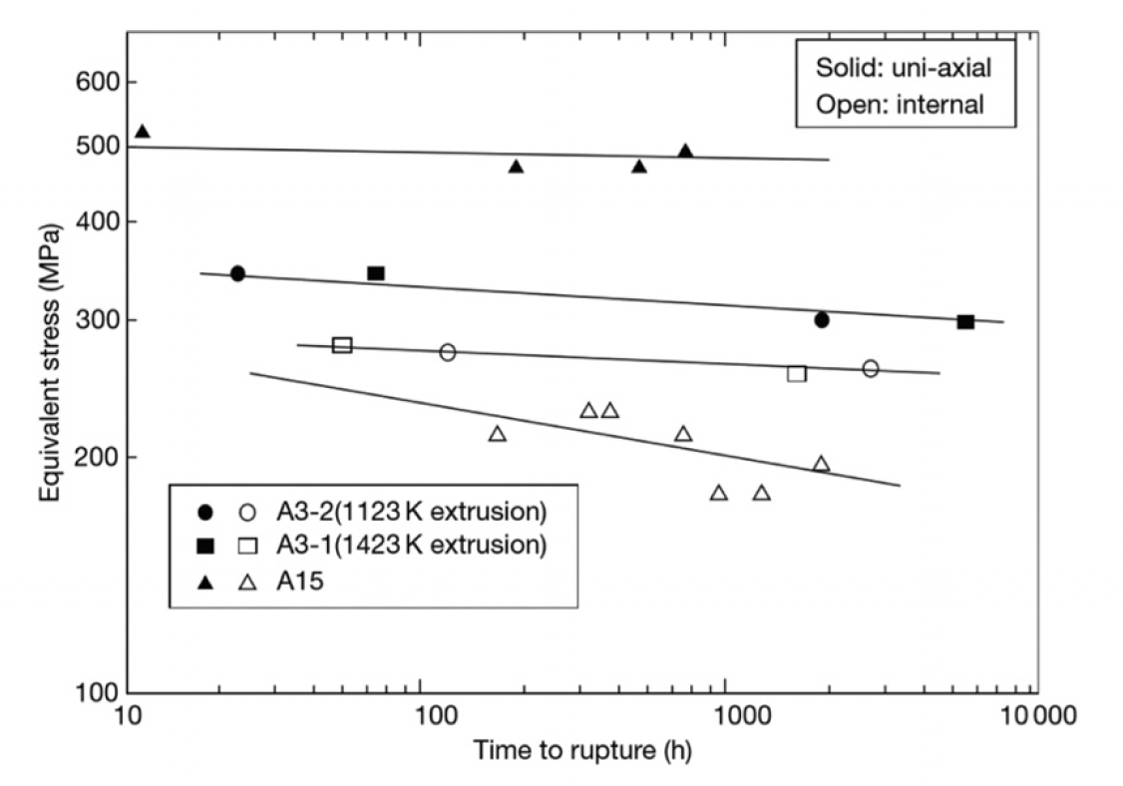
Ferritic 12Cr-ODS Steel
Development of ODS steels began with purely ferritic types, similar to MA957
While these types of steel exhibit excellent creep rupture resistance, there is anisotropy of the rupture strength
If the Y2O3 content is kept sufficiently low, an equiaxed grain structure can be maintained, providing more isotropic mechanical properties

Slide 18
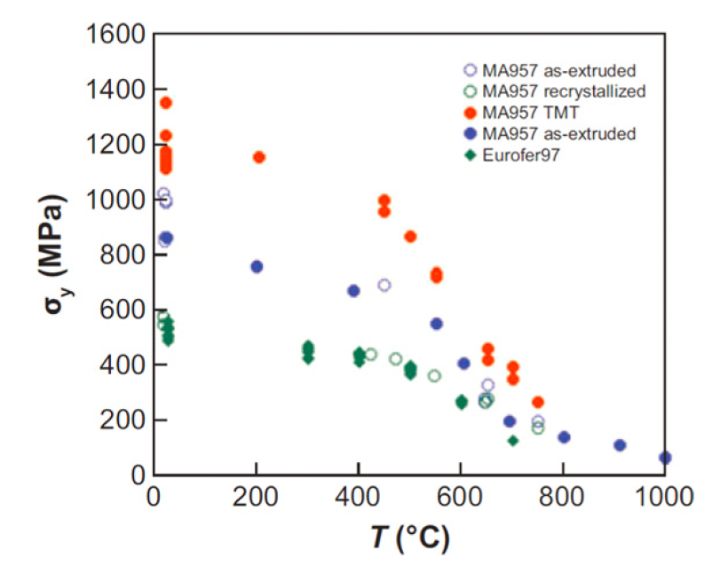
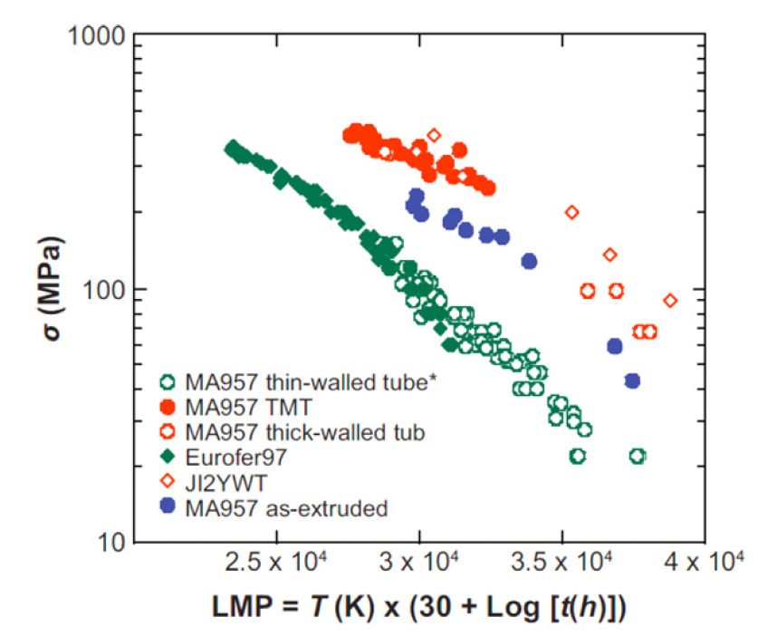
NFAs
Nanostructured ferritic alloys (NFAs) are 12%–20% Cr ferritic stainless steels that are dispersion strengthened by a very high density of ultrafine Y-Ti-O nanofeatures
This high density can yield excellent strength and radiation resistance, but make fabrication processes very difficult
MA957 and Eurofer are examples of NFAs

Slide 19
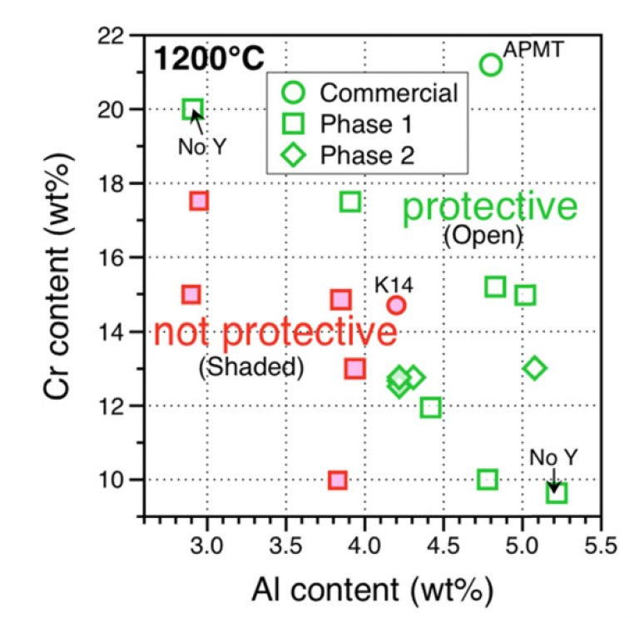
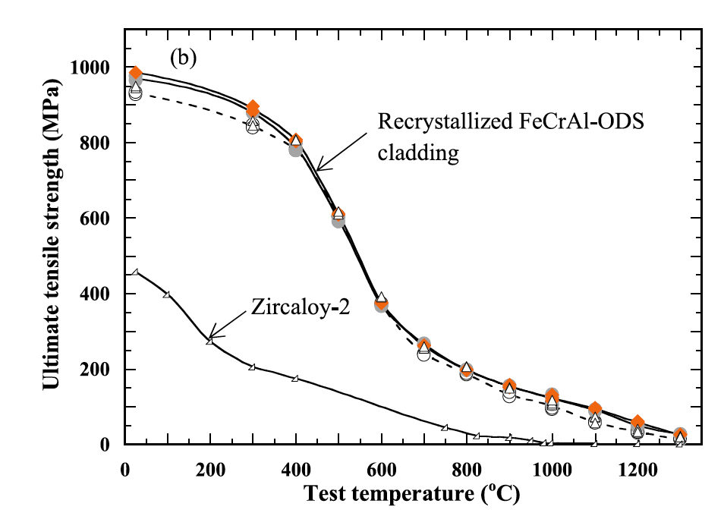
FeCrAl-ODS Steel
FeCrAl steels, with and without ODS are of interest since Al-containing steels produce the stable alumina (Al2O3) scale to prevent direct reaction of Fe with steam
A nominal composition of Fe-10Cr-6.1Al-0.3Zr (wt%) with 0.3wt% Y2O3 has been studied by ORNL
Zr is added to prevent Y-Al oxide particle formation

Slide 20
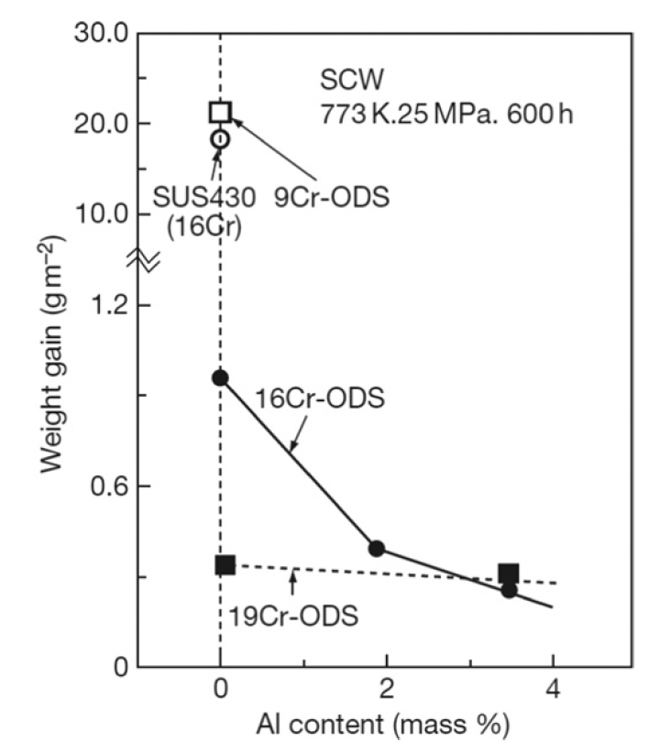
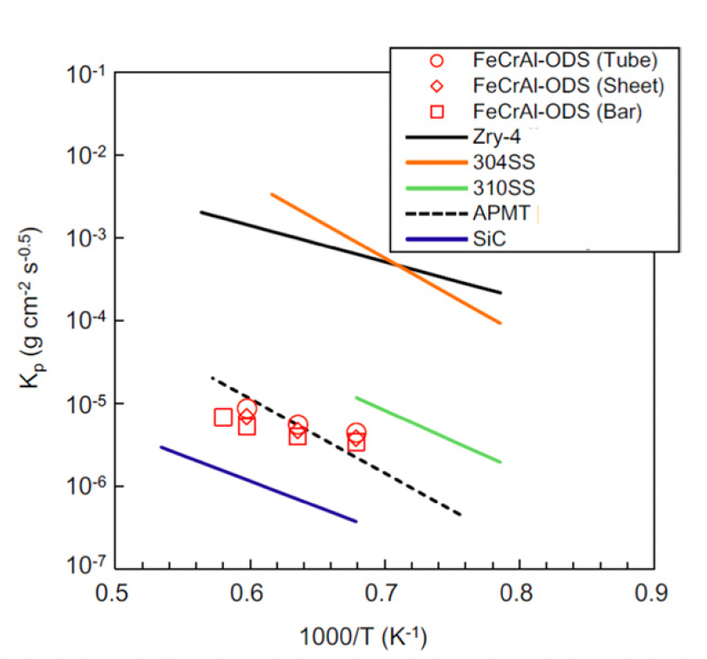
Corrosion
Hot steam oxidation tests are fairly limited in ODS steels
Additional Cr improves corrosion resistance, and Al content greater than 2 wt% provides a protective barrier
Excess oxygen content in the alloys can serve to suppress corrosion
In systems with high amounts of excess oxygen, Zr content can further aid in corrosion resistance

Slide 21
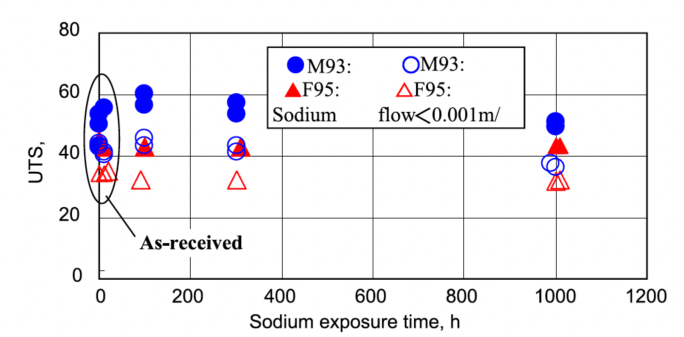
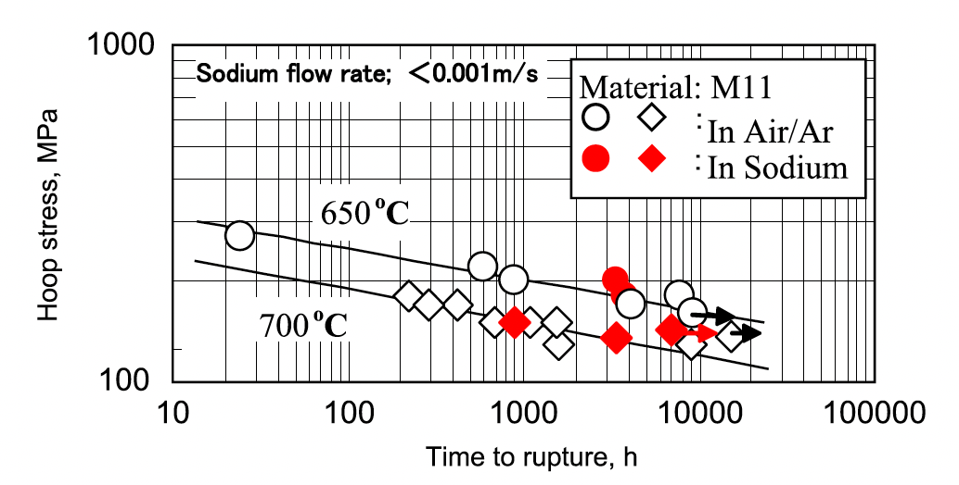
Liquid Na Compatibility
OSD-steels display excellent compatibility with liquid sodium
Both 9Cr and 12Cr ODS steels show no degradation in UTS after prolonged exposure to Na
Creep rupture behavior of ODS steels in air is identical to that in liquid Na
Under irradiation, this corrosion behavior may change, but has not been thoroughly studied

Slide 22
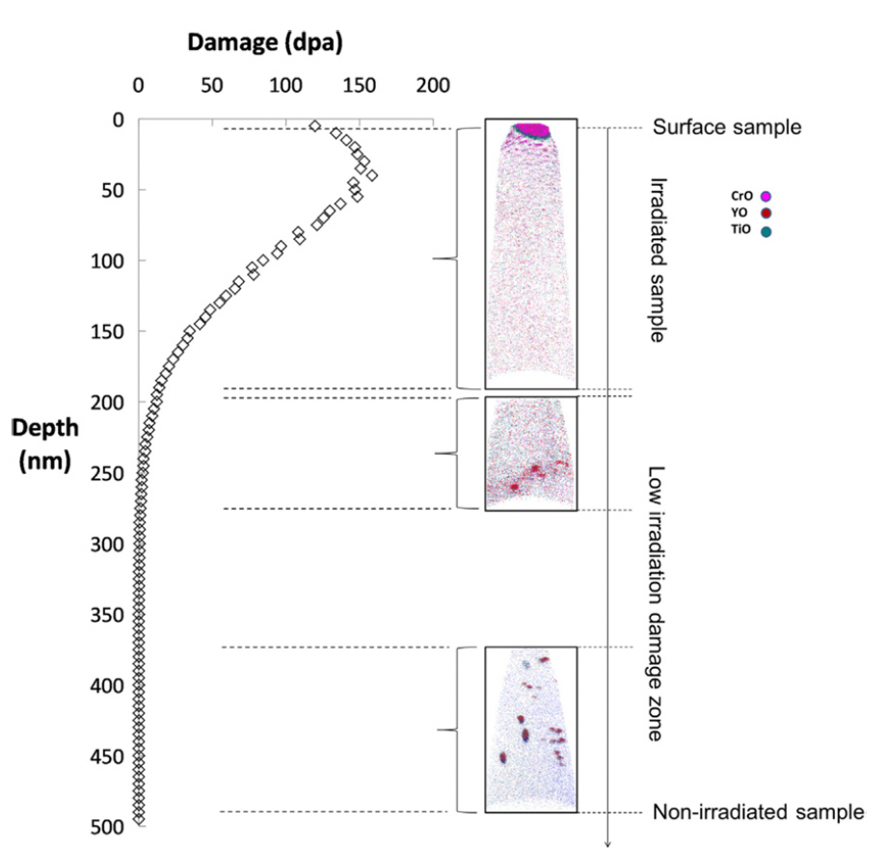
Irradiation Effects
The stability of the oxide particles under irradiation is the key factor in these alloys maintaining their advantageous mechanical properties under operation
Ballistic dissolution is the ejection of atoms from oxide particles due to high energy PKAs and the disordering of the particles

Slide 23
Irradiation Effects
At higher temperatures where vacancy diffusion is possible, ballistic dissolution works in conjunction with irradiation-assisted diffusion and changes the dispersion of oxide particles
The atoms ejected from oxide particles can diffuse back to the original oxide particles, stay in the matrix, or reach other oxide particles
Most research groups have reported that the size and number density of the oxide particles hardly change compared to how they were before irradiation
The predominant mechanism of these results are the recovery arising from back diffusion to the original oxide particles or re-join to other existing oxide particles

Slide 24
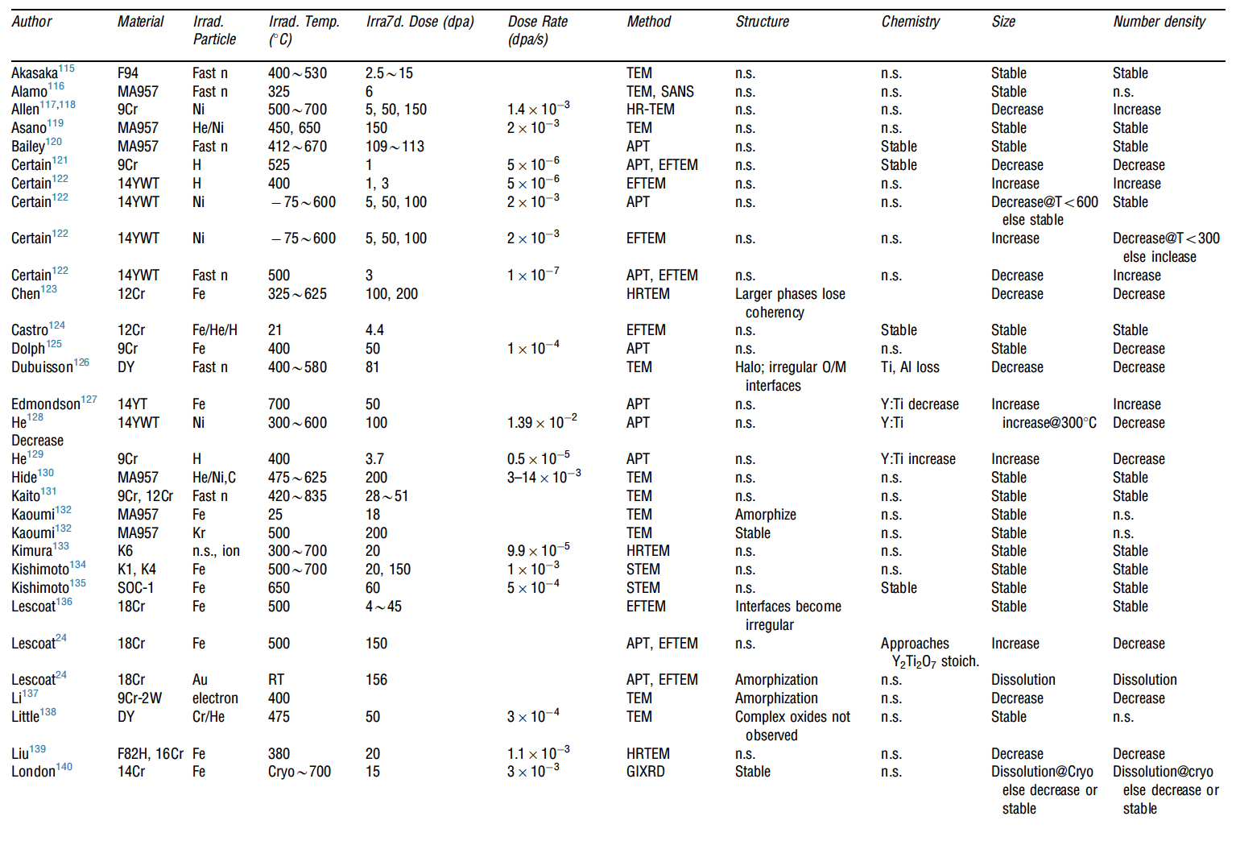
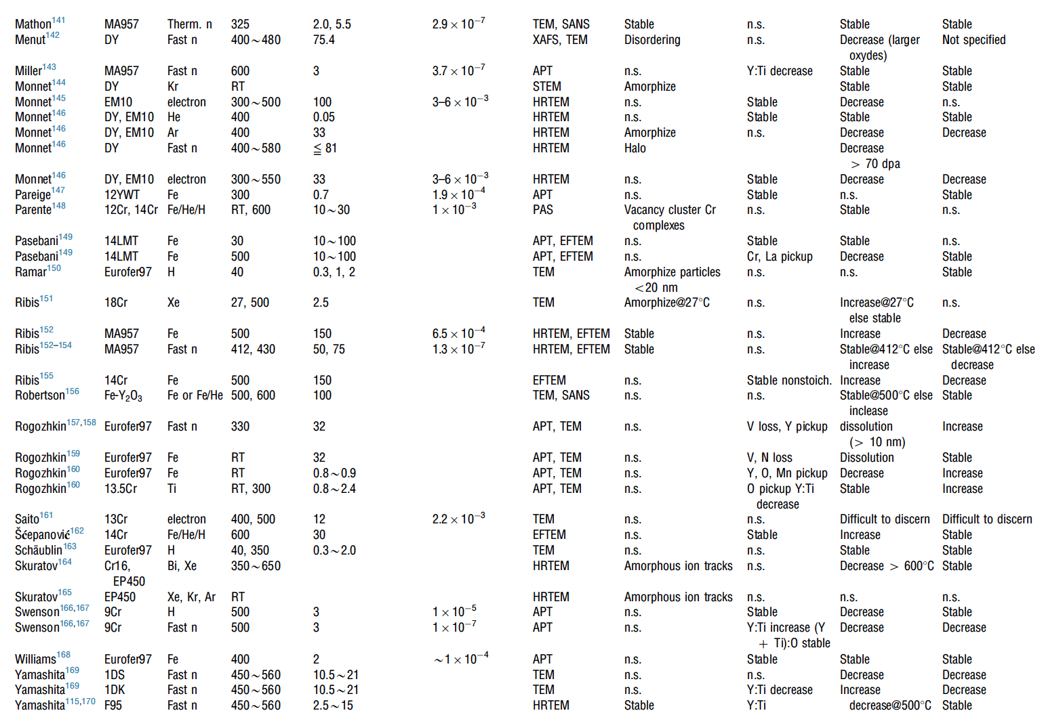
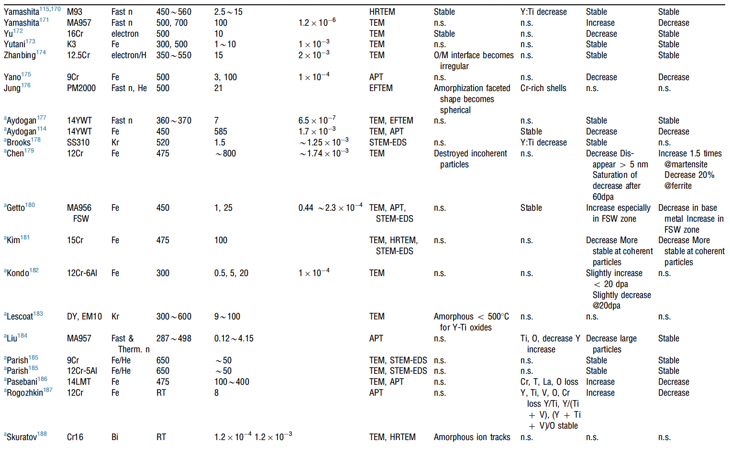
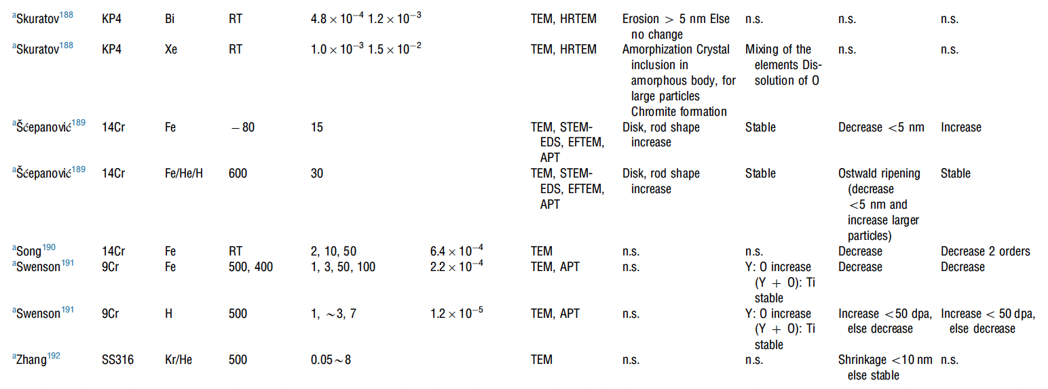
Irradiation Effects
A large number of irradiation experiments have been performed and analyzed to study the evolution of oxide particles
It appears that there is no correlation between irradiation dose, irradiation temperature, and the trend of change in size or number density of oxide particles

Slide 25
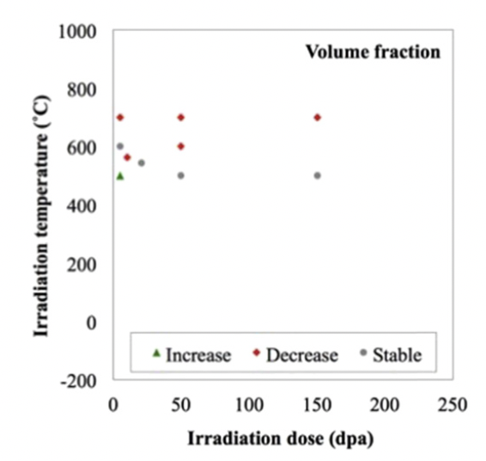
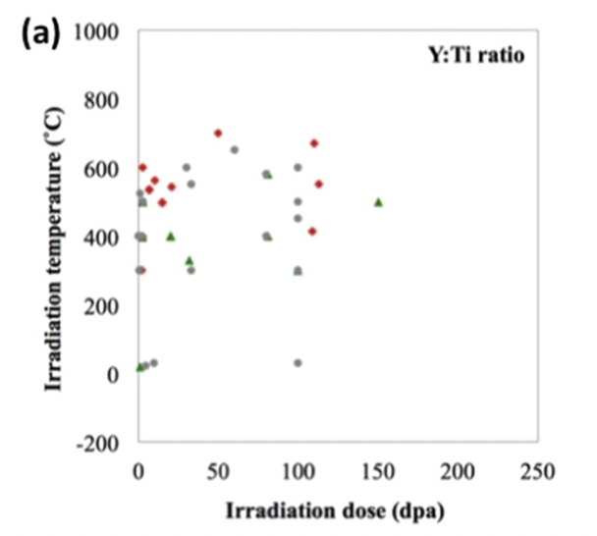
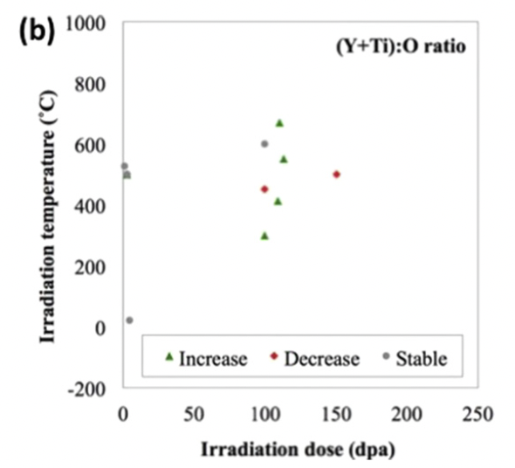
Irradiation Effects

Slide 26
Irradiation Effects
Swelling:
ODS steels are very swelling resistant, as the oxide particles trap vacancies and gas atoms, resulting in very small and homogeneously dispersed voids/bubbles
Hardening:
hardness increases due to irradiation in ODS steels are smaller than in non-ODS steels
Oxide particles dominate hardness, and act as sinks for generated point defects

Slide 27
Summary
ODS is fabricated through mechanical alloying and subsequent annealing
9Cr-ODS steel has a unique structure consisting of tempered martensite and residual ferrite that induces superior strength through finely dispersed oxide particles
NFAs have a very high density of oxide particles, producing very high strength and creep resistance, at the cost of workability
FeCrAl-ODS can provide superior corrosion resistance while retaining the ODS influenced mechanical properties
Further in-reactor studies on ODS steels need to be performed
While performance of ODS steels is widely studied, current production is limited to laboratory scale, with prohibitive costs for large scale production

Slide 28
Ni alloys

